Slide 1
Facial Expression Recognition using Convolutional Neural Network

Slide 2
ABSTRACT
Facial Expressions are an essential feature of non-verbal communication, as we move towards the digitization the human computer interactions plays a vital role. The aim is to classify facial image into one of the seven face detection classifiers using open CV and one of its classifiers for drawing the boundary box around the face to detect the correct expression.

Slide 3
INTRODUCTION
The objective is to classify each face based on the emotion shown in the facial expression into one of seven categories which are- 'Angry', 'Disgust', 'Fear', 'Happy', 'Neutral', 'Sad', 'Surprise' to train and test our algorithm using Convolution Neural Networks. OpenCV automatically detects faces in images and draw bounding boxes around them. Once trained, saved, and exported the CNN, it will directly serve the trained model to a web interface and perform real-time facial expression recognition on video and image data.

Slide 4
EMOTIONS
What is Emotions?
Emotions are reflected in voice, hand and body gestures, and mainly through facial expressions.
Why is it important to recognize emotions?
Human beings express emotions in day to day interactions
Understanding emotions and knowing how to react to people’s expressions greatly enriches the interaction
Classifier identifies 7 basic emotions:
Happiness
Sadness
Anger
Fear
Disgust
Surprise
No emotion (neutral)

Slide 5
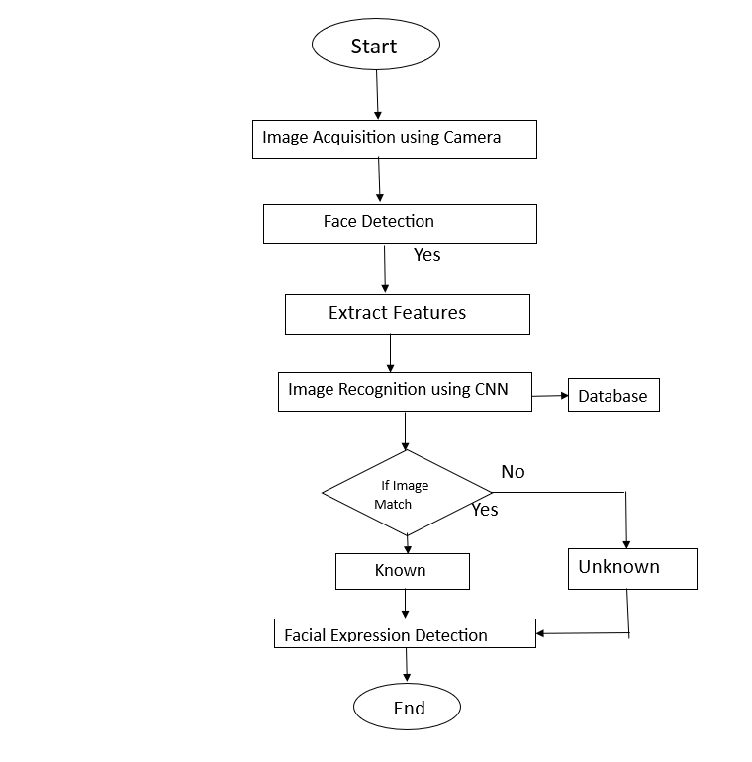
FLOW CHART

Slide 6
ADVANTAGES AND DISADVANTAGES
ADVANTAGES
DISADVANTAGES
Helps find missing people.
We can often detect a speaker’s emotion even if we can not understand the language.
Helps to initiate and maintain healthy social relationships and to participate successfully in a range of life activities and social situations.
Depends on age and gender. Angry males show higher levels of energy than angry females.
Facial expressions can easily be misunderstood and misinterpreted.
Technology can be manipulated

Slide 7
CONCLUSIONS
Our implementation is faster (due to server connection)
Can get input from different camera’s
Changed code to be more efficient
We have visualizations
Use face detection
Mask loading and recovery

Slide 8
ACKNOWLEDGEMENT
I would like to express my special thanks of gratitude to my project mentor Dr. Suparna Das Gupta who gave me the golden opportunity to do this project of Facial expression Recognition using CNN.
I came to know about so many new things and I am really thankful to my team for helping me to carry out this project within limited time.

Slide 9
SUBMITTED BY:
TEAM LEADER NAME: TUSHAR GHORUI
BRANCH : BTECH STREAM : IT YEAR : IV ROLL NO:123211004087
TEAM MEMBER 1 NAME: SUKANYA DAS
BRANCH : BTECH STREAM : IT YEAR : IV ROLL NO:123211004080
TEAM MEMBER 2 NAME: ANTARJITA DAS
BRANCH : BTECH STREAM : IT YEAR : IV ROLL NO:123211004010
TEAM MEMBER 3 NAME:KOYENA DEB
BRANCH : BTECH STREAM : IT YEAR : IV ROLL NO:123211004032
TEAM MEMBER 4 NAME: AHIRI BASU
BRANCH : BTECH STREAM : IT YEAR : IV ROLL NO:123211004002
TEAM MENTOR NAME : DR. SUPARNA DASGUPTA
CATEGORY : ACADEMIC EXPERTISE : IOT, NETWORKING DOMAIN EXPERIENCE (IN YEARS): 10YRS

Slide 10
THANK YOU

